Slide 1
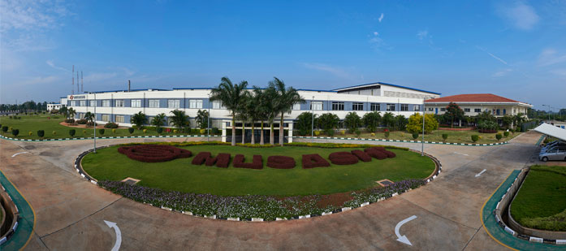
Manufacturing unit
Seisan koujou

Slide 2
Human Resource
JINJI
Finance
KEIRI
Purchase
KOUBAI
Sales
EIGYO
Manufacturing Engineering
SEISAN GIJYUTSU
Maintenance
HOZEN OR MENTE
Quality
HINSHITSU
Factory Control
SEISAN KANRI OR SEIKAN

Slide 3
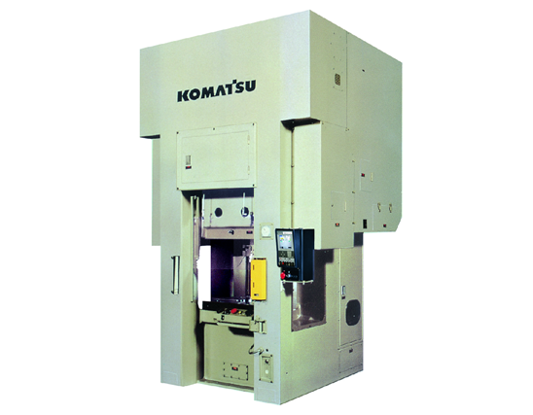
FORGING
TANZOU
BILLET CUTTING
OR
SAWING
SETSU-DAN
HOT FORGING
NEKKAN
PIERCING
PIASU
PROCESS IN JAPANESE IS CALLED “ KOUTEI”

Slide 4
